Slide 1
PEDRO SOLA · AGENTIC AI PLATFORM
System Report · März 2026
Powered by BAISE · LuxTech v4 Design System

Slide 2
EXECUTIVE SUMMARY
▸ 36 Docker Container · 12 Subdomains · 5 Cognee Datasets
▸ 858 Knowledge Nodes · 2.546 Edges im Cognee Graph
▸ 122 installierte Skills · 7 aktive API-Endpunkte
▸ BAISE LuxTech v4 Design System implementiert
▸ Nginx Reverse Proxy + Basic Auth auf allen Services
▸ n8n Workflow Engine · ERPNext ERP · Cognee Knowledge Graph
Infrastructure: Ubuntu 22.04 VPS · 72.61.176.72
Agent Runtime: OpenClaw + Claude Opus 4.6 · Telegram Channel
Knowledge Engine: Cognee v0.1.21 · Neo4j + Qdrant Backend

Slide 3
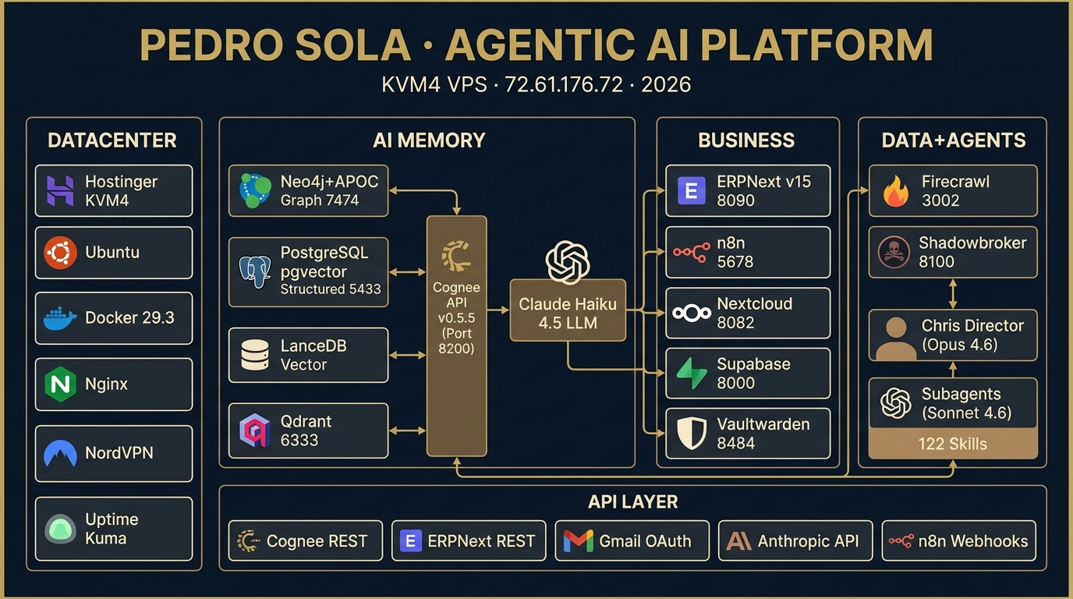

Slide 4
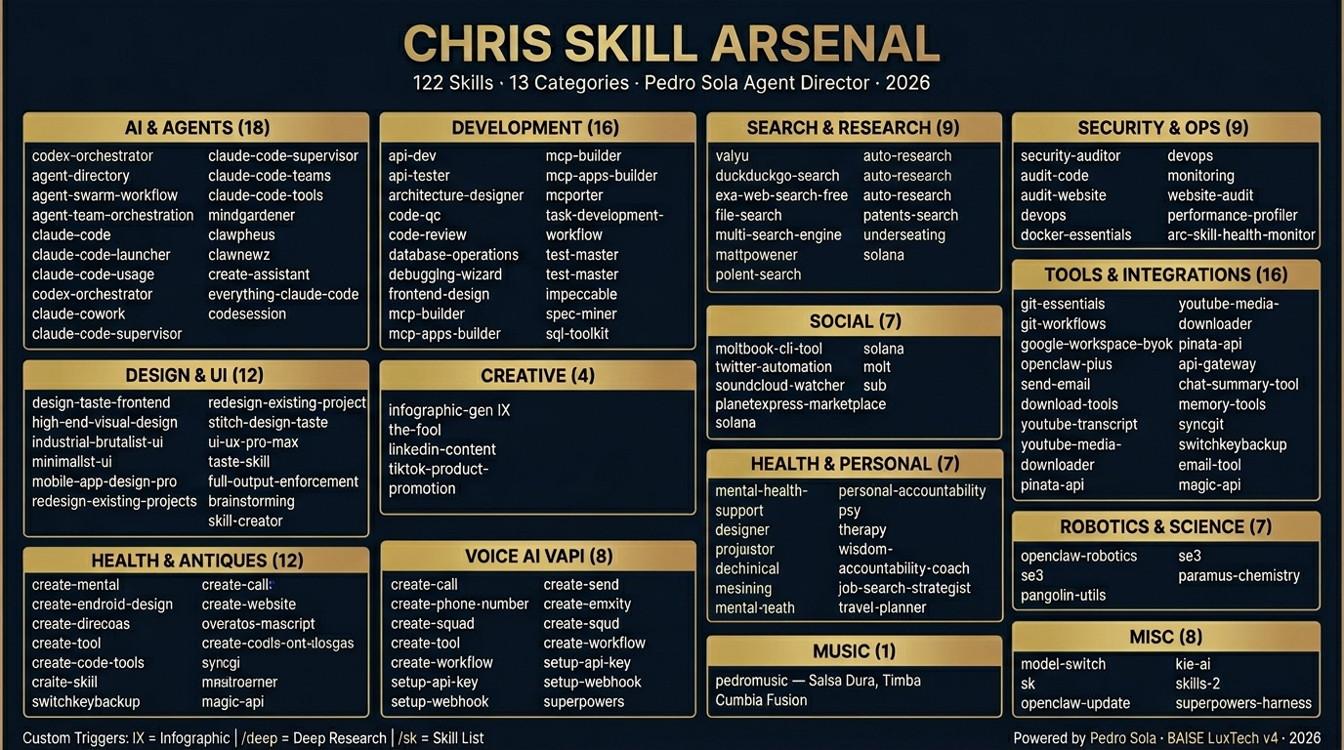

Slide 5
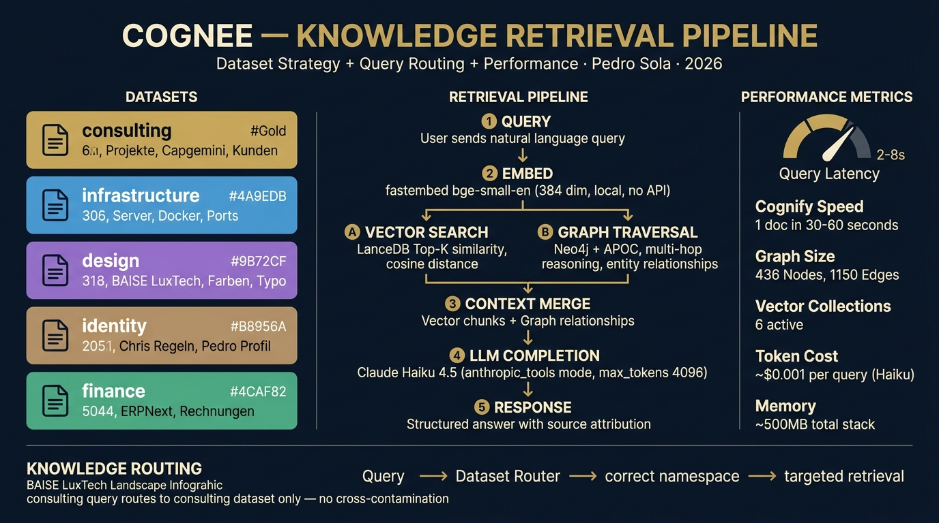

Slide 6
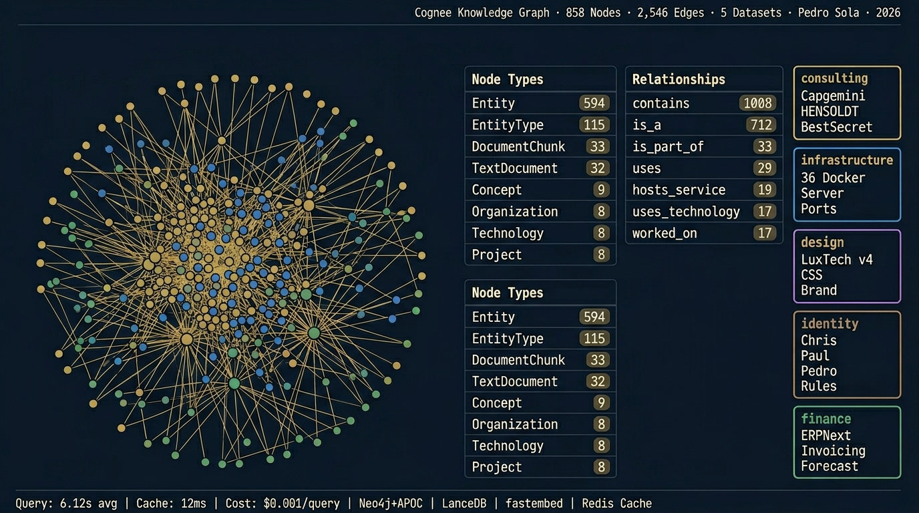

Slide 7
SERVICES ÜBERSICHT
Service
Subdomain
Port
Status
Auth
OpenClaw Gateway
—
44587
✅ Active
Token
n8n Workflows
n8n.pedrosolanextgen.io
5678
✅ Active
Basic Auth
Cognee API
cognee.pedrosolanextgen.io
8000
✅ Active
API Key
Neo4j Browser
neo4j.pedrosolanextgen.io
7474
✅ Active
Auth
Neo4j Bolt
—
7687
✅ Active
Auth
Qdrant Vector DB
qdrant.pedrosolanextgen.io
6333
✅ Active
No Auth
ERPNext
erp.pedrosolanextgen.io
8080
✅ Active
Login
Nginx Proxy
pedrosolanextgen.io
80/443
✅ Active
—
Portainer
portainer.pedrosolanextgen.io
9443
✅ Active
Login
Grafana
grafana.pedrosolanextgen.io
3000
⏳ Planned
OAuth
Uptime Kuma
status.pedrosolanextgen.io
3001
⏳ Planned
Login
Landing Page
pedrosolanextgen.io
80
✅ Active
Public

Slide 8
BAISE LUXTECH V4 · DESIGN SYSTEM
Navy #0A1628
Gold #C5A55A
Bronze #A37846
Cream #F5ECD7
CSS Custom Properties
--color-bg-primary: #0A1628;
--color-bg-secondary: #0D1F38;
--color-accent-gold: #C5A55A;
--color-accent-bronze: #A37846;
--color-text-primary: #F5ECD7;
--color-text-secondary: #B8A88A;
--font-primary: 'Inter', sans-serif;
--font-mono: 'JetBrains Mono', monospace;
--border-radius: 12px;
--shadow-card: 0 4px 24px rgba(0,0,0,0.4);
Typography & Effects
Primary: Inter (Variable)
Weight: 300 / 400 / 600 / 700
Mono: JetBrains Mono
Scale: 12 / 14 / 16 / 20 / 28 / 42
Glassmorphism Cards
Subtle Gold Gradients
Hardware-Accelerated Transitions

Slide 9
COGNEE DATASET-ARCHITEKTUR
CONSULTING
Beratungswissen, Methoden, Frameworks, Client-Cases
INFRASTRUCTURE
Docker, Nginx, Services, Deployment-Configs
DESIGN
BAISE LuxTech v4, UI/UX Patterns, Brand Guidelines
IDENTITY
Pedro Sola Profil, SOUL.md, Agent-Konfiguration
FINANCE
Finance Transformation, KI Use Cases, Marktanalysen
RETRIEVAL PIPELINE
Query
→
Embed
→
Vector Search
→
Graph Traverse
→
LLM Synthesis
→
Answer

Slide 10
SECURITY AUDIT
▸ 7 nicht-essentielle Ports geschlossen via iptables
▸ iptables-persistent für Reboot-Sicherheit
▸ SSH Key-Only Auth (Passwort deaktiviert)
▸ fail2ban aktiv auf SSH
▸ UFW Firewall konfiguriert
▸ 12 Nginx Reverse Proxy Configs
▸ Basic Auth auf sensiblen Endpoints
▸ Rate Limiting auf API-Endpunkte
▸ CORS Headers konfiguriert
NETZWERK & CONTAINER
▸ Alle Docker Container in isoliertem Netzwerk
▸ Secrets via Environment Variables
▸ Keine Default-Passwörter in Production
▸ Log Rotation konfiguriert
⚠ Offene Punkte:
· Let's Encrypt SSL noch ausstehend
· WAF (Web Application Firewall) empfohlen
· Automated Security Scanning einrichten
· Backup-Strategie implementieren

Slide 11
NÄCHSTE SCHRITTE
PRIORITY 1
PRIORITY 2
PRIORITY 3
PRIORITY 4
DNS + SSL
n8n Workflows
Cognee Query Router
ERPNext Stammdaten
▸ DNS Records für alle 12 Subdomains
▸ Automated Reporting Pipeline
▸ Multi-Dataset Query Routing
▸ Company & Chart of Accounts
▸ Let's Encrypt Wildcard-Zertifikat
▸ Cognee Ingestion Triggers
▸ Context-Aware Retrieval
▸ Client/Project Tracking
▸ HTTPS Redirect enforced
▸ Telegram Alert Workflows
▸ Hybrid Search (Vector + Graph)
▸ Invoice & Proposal Templates

Slide 12
PEDRO SOLA
NextGen Finance · Agentic AI Consulting
✉ pedro.sola.nextgen@gmail.com
🌐 pedrosolanextgen.io
Powered by BAISE · Built with OpenClaw + Claude Opus 4.6

